Slide 1
EBAY company financial analysis

Slide 2
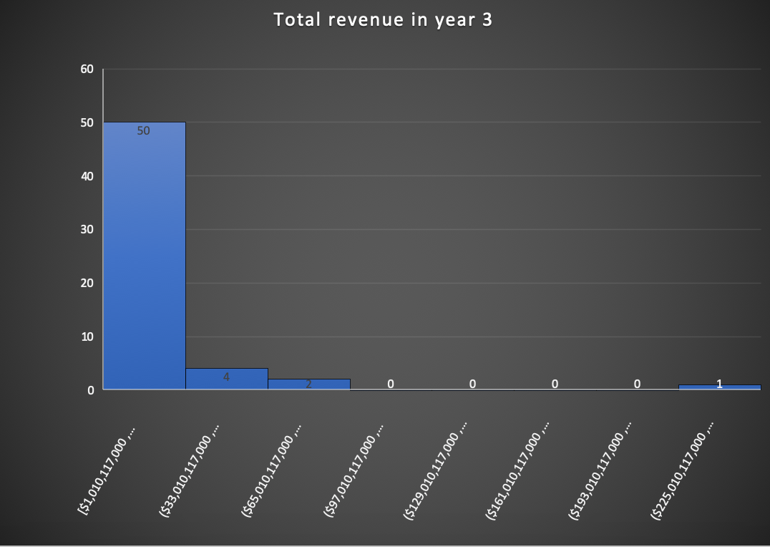
For my analysis of entire project I picked particularly company EBAY that’s why here I analyze total revenue of Information Technology sector in year 3. In this case we can see that the histogram is right skewed which means that Average (mean) of total revenue in year 3 is higher than median total revenue.
Mean = 15,973,030,215
Median = 5,066,000,000
Mean total revenue of Technology companies for year 3 triples the value of median total revenue.
The most frequent total revenue was between 1-38 BB for 50 companies in Year 3 for Technology companies
Histogram of total revenue for Information Technology companies for year 3

Slide 3
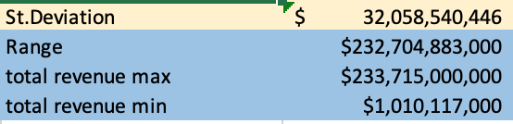
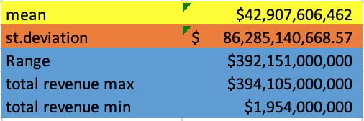
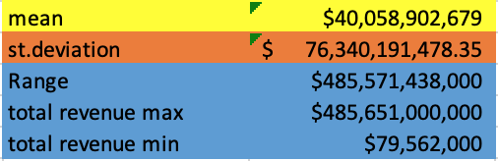
Standard deviation and range of Technology companies for year 3
Technology companies
St.Deviation of Technology companies for year 3 is $32,058,540,446 which is a very high number what can tell us that the spread from the mean is very high. It can be explained by a very high revenue of Apple 233> BB in 3rd year of operation and the fact that other companies in the same sector for the same time period did much worse than Apple company. Also the next two companies with the highest revenue have more than 65BB of revenue for year 3. However, for the sake of comparison I provided some information for Energy and Consumer Staples sectors where we can see St.Deviation is higher (76 and 86 BB) than in Technology companies sector(32BB) what tells us about bigger difference in performance in this two sectors between the best and worst companies.
The values a spread out with the range of $232,704,883,000.
Energy
Consumer Staples

Slide 4
EBAY analysis
For my second project I chose EBAY as the company for my analysis. The reasons are the following:
1)EBAY is one of the first companies who created the platform for selling/buying items through the internet;
2) I personally use EBAY for selling my school books and other stuff and that usually works well for me;
3) There are many other platforms available right now where selling/purchasing can be easier;
4) By using some other platforms for selling/buying, such as Amazon, Facebook Marketplace, I’d like to see what impact EBAY’s policies and rules have on their development as the company;
5) Finally, analysis can show whether or not EBAY board of director have something to work on in order to stay on track with other Technology companies.

Slide 5
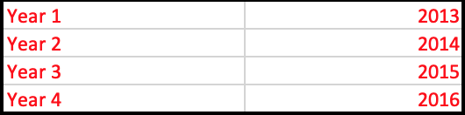
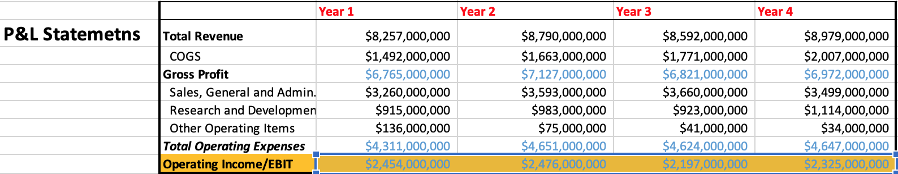
P&L Statement for years 2013-2016

Slide 6
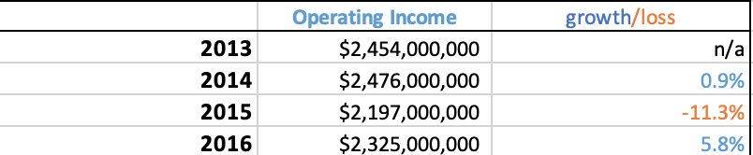
In year 2014 operating income grew on 0.9% in comparison with year 2013 while in year 2015 Operating income declined by significant (11.3%) in comparison with year 2014, growing in 2015 by 5.8% comparing to year 2014

Slide 7
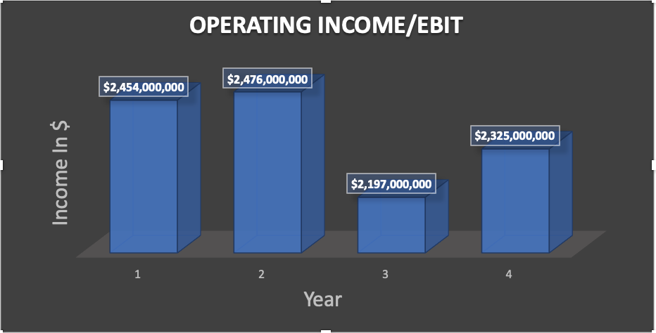
Bottom line is that EBAY Operating income at EBAY for the years given in NYSE spreadsheet was inconsistent having its ups and downs. We can visually see it on the chart bellow.

Slide 8
The problem is that in year 4 (i.e. 2016) operating income is less than in year 1 (2013). The board of directors will have to take an action in order to bring the Operating income back to the standard of year one with the growth in following years. If they want to stay on track of growth and keep their investors and shareholders happy they will have to create several scenarios of Growth in following 2 years.

Slide 9
Thus, I created several scenarios of growth of Revenue growth (%), Gross margin, and Operating margin for years 2017 and 2018:
1)Strong – I take the highest percentage of growth for the periods given;
2) Base – I’ll take the mean of historical data;
3) Weak – I’ll take the lowest point of growth in the data provided.

Slide 10
Historical Revenue growth ranged from (-2.25255973)-6.45519%. So, I’ll consider the following scenarios of growth of Revenue:
1) Strong case = max historical growth = 6.45519% in year 2017, 6.6% in 2018;
2) Base case = mean = 2.9%;
3) Weak case = min historical growth = -2.25254%

Slide 11
Historical Gross margin ranged between 0.776-0.819. So, I’ll consider the following scenarios of growth of Gross margin:
1) Strong case = max historical growth = 0.8193;
2) Base case = mean = 0.8;
3) Weak case = min historical growth = 0.776%

Slide 12
Historical Operating margin ranged from 0.255703-0.2972. So, I’ll consider the following scenarios of growth of Operating margin:
1) 1) Strong case = max historical growth = 0.2972;
2) Base case = mean = 0.273;
3) Weak case = min historical growth = 0.255703%

Slide 13
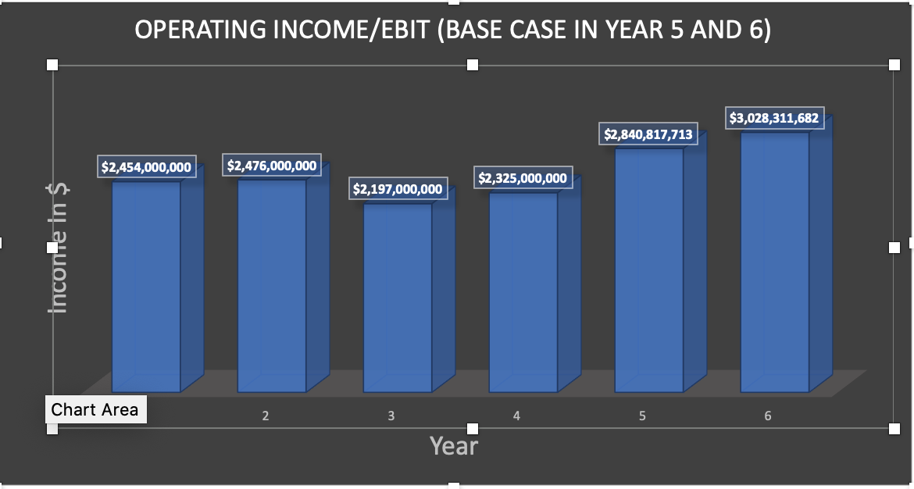
From this chart we can see that in Best case scenario of growth of Operating income by 6.45519% in 2017 and 6.6% in 2018, Gross margin by 0.8193, and Operating Margin by 0.2972 operating income in 2017 exceeds all 4 previous year and will continue its growth in 2018 and will be equal to 3,028,311,682. Great case scenario!!!

Slide 14
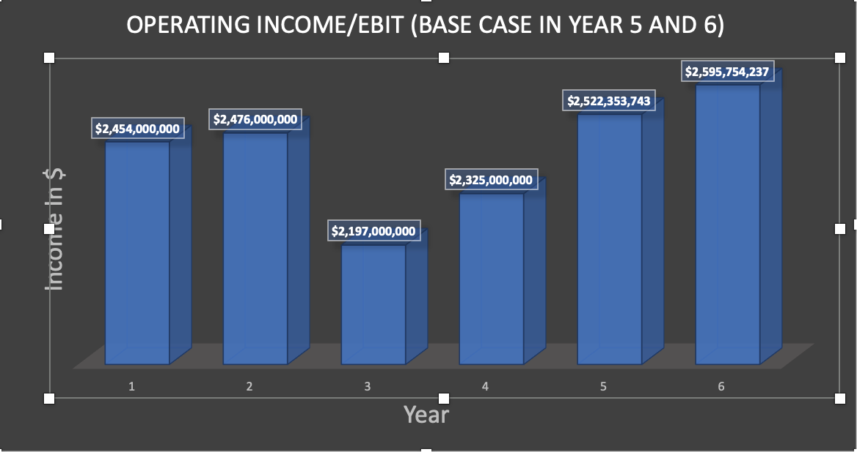
From this chart we can see that in Base case scenario of growth of Operating income by 2.9%;, Gross margin by 0.8, and Operating Margin by 0.273 operating income in 2017 will continue its growth and yet results in 2017 and 2018 are very good reaching $2,595,754,237 in 2018. Very good case scenario!

Slide 15
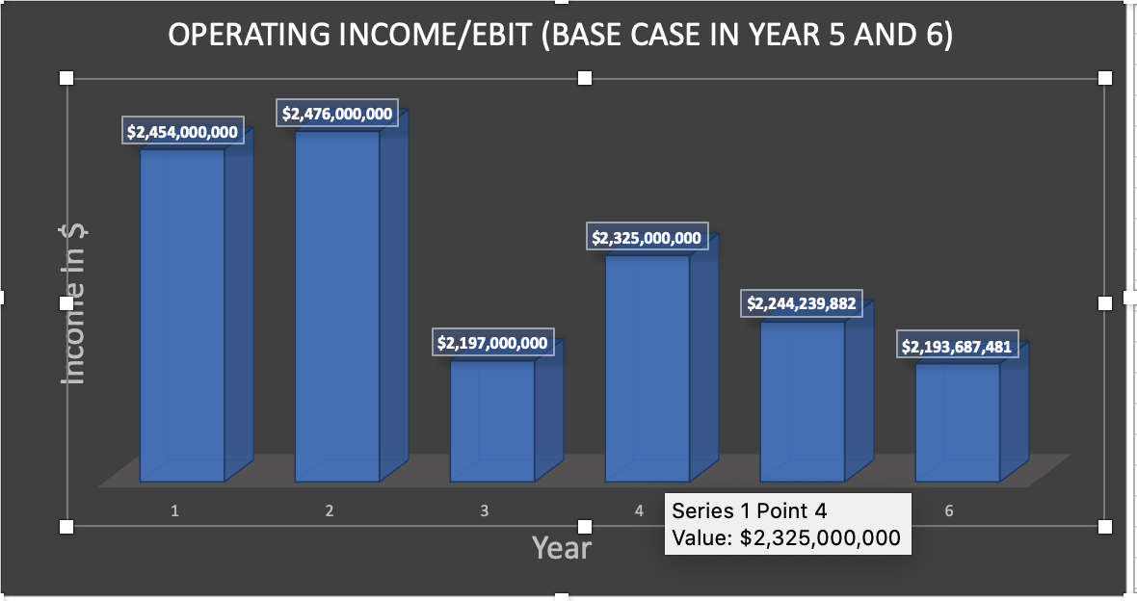
Yet, if the company we’ll reach a weak case scenario of growth of Operating income by -2.25254% as it was in year 2015, Gross margin by 0.776 as it was in year 2016, and Operating Margin by 0.255703 as it was in 2015, operating income in 2017 will fall down as it was in year of 2015 and will result in 2017 $2,244,239,82 and 2018 $2,193,687,481. Very bad case scenario!

Slide 16

From my analysis and the charts I provided it’s clear to me that year 2015 was a bad year for eBay and their loss in Operating income declined by 11.3%. In 2016 it went up by 5.8% but stayed lower than it was in year 2014. If EBAY wants to keep their shareholders the management have to consider Strong and/or Base case scenarios in order to continue its growth. In case of Weak case scenario Operating income will continue to decline and year 2018 will result in lower Operating Income than it was in 2013. The next steps are for the management or the company in the way of operations how to reach base or better best case scenario.

